Slide 1

From Control-Centric Programming to Data-Centric Optimization
Alexandru Calotoiu,
With contributions from Tal Ben-Nun, Berke Ates, Grzegorz Kwasniewski, Johannes de Fine Licht, Timo Schneider, Philipp Schaad, Alexandru Nikolas Ziogas, Marcin Copik, Torsten Hoefler

Slide 2
Performance Metaprogramming for Performance Portability
Ben-Nun, de Fine Licht, Ziogas, TH: Stateful Dataflow Multigraphs: A Data-Centric Model for High-Performance Parallel Programs, SC19

Slide 3






Performance Metaprogramming for Performance Portability
Domain Scientist
$$\frac{∂u}{∂t}−α∇^{2}u=0$$
DSLs
Ben-Nun, de Fine Licht, Ziogas, TH: Stateful Dataflow Multigraphs: A Data-Centric Model for High-Performance Parallel Programs, SC19

Slide 4
Performance Metaprogramming for Performance Portability
Domain Scientist
$$\frac{∂u}{∂t}−α∇^{2}u=0$$
DSLs
Ben-Nun, de Fine Licht, Ziogas, TH: Stateful Dataflow Multigraphs: A Data-Centric Model for High-Performance Parallel Programs, SC19

Slide 5

Performance Metaprogramming for Performance Portability
Domain Scientist
$$\frac{∂u}{∂t}−α∇^{2}u=0$$
DSLs
Applied Scientist
translate DSL into
parametric dataflow graphs
SDFG Builder API
Multi-Level
Library Nodes
Ben-Nun, de Fine Licht, Ziogas, TH: Stateful Dataflow Multigraphs: A Data-Centric Model for High-Performance Parallel Programs, SC19

Slide 6
Performance Metaprogramming for Performance Portability
Domain Scientist
$$\frac{∂u}{∂t}−α∇^{2}u=0$$
DSLs
Applied Scientist
translate DSL into
parametric dataflow graphs
SDFG Builder API
Multi-Level
Library Nodes
Ben-Nun, de Fine Licht, Ziogas, TH: Stateful Dataflow Multigraphs: A Data-Centric Model for High-Performance Parallel Programs, SC19

Slide 7

Performance Metaprogramming for Performance Portability
Domain Scientist
Performance Engineer
$$\frac{∂u}{∂t}−α∇^{2}u=0$$
DSLs
Parametric Dataflow
Graphs (SDFG)
Applied Scientist
$$L$$
$$R$$
translate DSL into
parametric dataflow graphs
*
*
*
*
SDFG Builder API
Multi-Level
Library Nodes
*
*
Graph Transformations
(API, Interactive)
Ben-Nun, de Fine Licht, Ziogas, TH: Stateful Dataflow Multigraphs: A Data-Centric Model for High-Performance Parallel Programs, SC19

Slide 8




Performance Metaprogramming for Performance Portability
Domain Scientist
Performance Engineer
$$\frac{∂u}{∂t}−α∇^{2}u=0$$
DSLs
Specialized
Code Generation
Transformed
Dataflow
Parametric Dataflow
Graphs (SDFG)
CPU Code
Applied Scientist
$$L$$
$$R$$
Performance
Results
translate DSL into
parametric dataflow graphs
*
Runtime
GPU Code
*
*
*
FPGA Code
SDFG Builder API
Multi-Level
Library Nodes
*
*
Graph Transformations
(API, Interactive)
C++ code generation/runtime
Ben-Nun, de Fine Licht, Ziogas, TH: Stateful Dataflow Multigraphs: A Data-Centric Model for High-Performance Parallel Programs, SC19

Slide 9
Performance Metaprogramming for Performance Portability
10s of SLOC
Domain Scientist
Performance Engineer
$$\frac{∂u}{∂t}−α∇^{2}u=0$$
DSLs
Specialized
Code Generation
Transformed
Dataflow
Parametric Dataflow
Graphs (SDFG)
CPU Code
Applied Scientist
$$L$$
$$R$$
Performance
Results
translate DSL into
parametric dataflow graphs
*
Runtime
GPU Code
*
*
*
FPGA Code
SDFG Builder API
Multi-Level
Library Nodes
*
*
Graph Transformations
(API, Interactive)
C++ code generation/runtime
Ben-Nun, de Fine Licht, Ziogas, TH: Stateful Dataflow Multigraphs: A Data-Centric Model for High-Performance Parallel Programs, SC19

Slide 10
Performance Metaprogramming for Performance Portability
10s of SLOC
Domain Scientist
Performance Engineer
$$\frac{∂u}{∂t}−α∇^{2}u=0$$
DSLs
Specialized
Code Generation
Transformed
Dataflow
Parametric Dataflow
Graphs (SDFG)
CPU Code
Applied Scientist
$$L$$
$$R$$
Performance
Results
translate DSL into
parametric dataflow graphs
*
Runtime
GPU Code
*
*
*
FPGA Code
SDFG Builder API
Multi-Level
Library Nodes
*
*
Graph Transformations
(API, Interactive)
C++ code generation/runtime
Ben-Nun, de Fine Licht, Ziogas, TH: Stateful Dataflow Multigraphs: A Data-Centric Model for High-Performance Parallel Programs, SC19

Slide 11
Performance Metaprogramming for Performance Portability
10s of SLOC
Domain Scientist
Performance Engineer
$$\frac{∂u}{∂t}−α∇^{2}u=0$$
100s of reusable SLOC
DSLs
Specialized
Code Generation
Transformed
Dataflow
Parametric Dataflow
Graphs (SDFG)
CPU Code
Applied Scientist
$$L$$
$$R$$
Performance
Results
translate DSL into
parametric dataflow graphs
*
Runtime
GPU Code
*
*
*
FPGA Code
SDFG Builder API
Multi-Level
Library Nodes
*
*
Graph Transformations
(API, Interactive)
C++ code generation/runtime
Ben-Nun, de Fine Licht, Ziogas, TH: Stateful Dataflow Multigraphs: A Data-Centric Model for High-Performance Parallel Programs, SC19

Slide 12
Performance Metaprogramming for Performance Portability
10s of SLOC
Domain Scientist
Performance Engineer
$$\frac{∂u}{∂t}−α∇^{2}u=0$$
100s of reusable SLOC
DSLs
Specialized
Code Generation
Transformed
Dataflow
Parametric Dataflow
Graphs (SDFG)
CPU Code
Applied Scientist
$$L$$
$$R$$
Performance
Results
translate DSL into
parametric dataflow graphs
*
Runtime
GPU Code
*
*
*
FPGA Code
SDFG Builder API
Multi-Level
Library Nodes
*
*
Graph Transformations
(API, Interactive)
C++ code generation/runtime
Ben-Nun, de Fine Licht, Ziogas, TH: Stateful Dataflow Multigraphs: A Data-Centric Model for High-Performance Parallel Programs, SC19

Slide 13
Performance Metaprogramming for Performance Portability
10s of SLOC
Domain Scientist
Performance Engineer
$$\frac{∂u}{∂t}−α∇^{2}u=0$$
1000s of auto-generated SLOC
100s of reusable SLOC
DSLs
Specialized
Code Generation
Transformed
Dataflow
Parametric Dataflow
Graphs (SDFG)
CPU Code
Applied Scientist
$$L$$
$$R$$
Performance
Results
translate DSL into
parametric dataflow graphs
*
Runtime
GPU Code
*
*
*
FPGA Code
SDFG Builder API
Multi-Level
Library Nodes
*
*
Graph Transformations
(API, Interactive)
C++ code generation/runtime
Ben-Nun, de Fine Licht, Ziogas, TH: Stateful Dataflow Multigraphs: A Data-Centric Model for High-Performance Parallel Programs, SC19

Slide 14

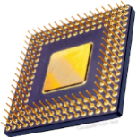

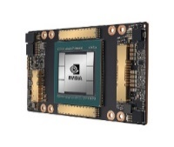

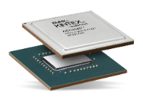


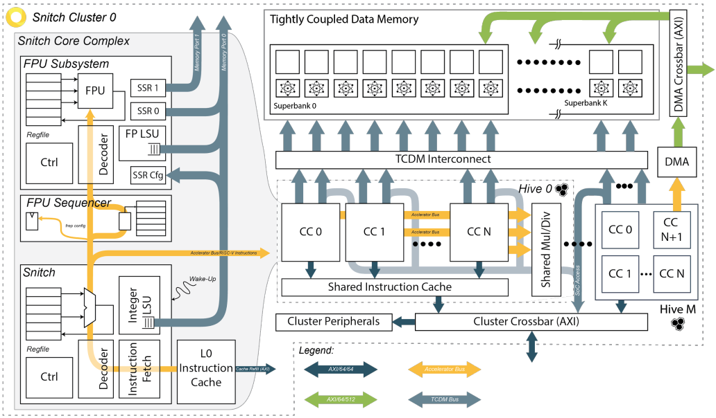


DaFlEx project summary
DaCe
F2DaCe
Dataflow extaction
Snitch
C2DaCe
MLIR-DaCe
available in DaCe
developed in DaFlEx
to be developed in DaFlEx
Notes:
Context: DaCe is a parallel programming framework that takes code in Python, Tensorflow or Matlab as in input and maps it high-performance CPU, GPU and FPGA programs, leveraging a data-centric intermediate representation (Stateful Dataflow Multigraphs - SDFGs) to optimize and parallelize applications beyond what compilers of procedural languages can currently achieve.
Overview and motivation: The DaFlEx project aims to expand the capabilities of DaCe by automating the process of lifting procedural codes written in C, C++ and Fortran to the DaCe intermediate representation. This would allow numerous existing, legacy codes access to be optimized using powerful data-centric transformations without requiring extensive user rewrites. At the same time, it is planned to expand the code-generation capability of DaCe to the Snitch platform, enabling the utilization of its powerful features without requiring application redesign.
Status
In the first year, work was focused on generating on lifting C code semantics into the data-centric representation. The work is currently submitted at ICS and available on ArXiv. The code is available on Github.
The most notable result is the automatic parallelization of the most time-intensive LULESH routine, accounting for over 60% of total runtime. The version generated by C2DaCe outperforms not only all other auto-parellization tools, but also the version optimized by the application developers.

Slide 15
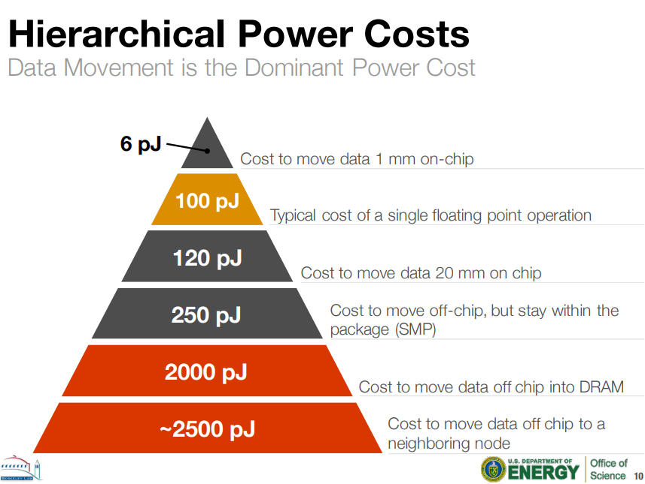
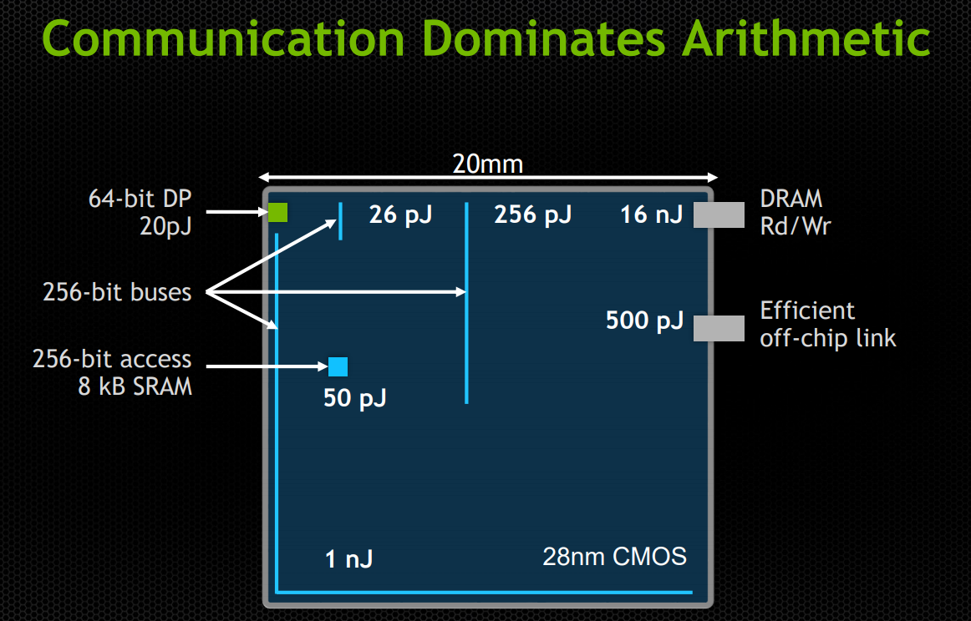
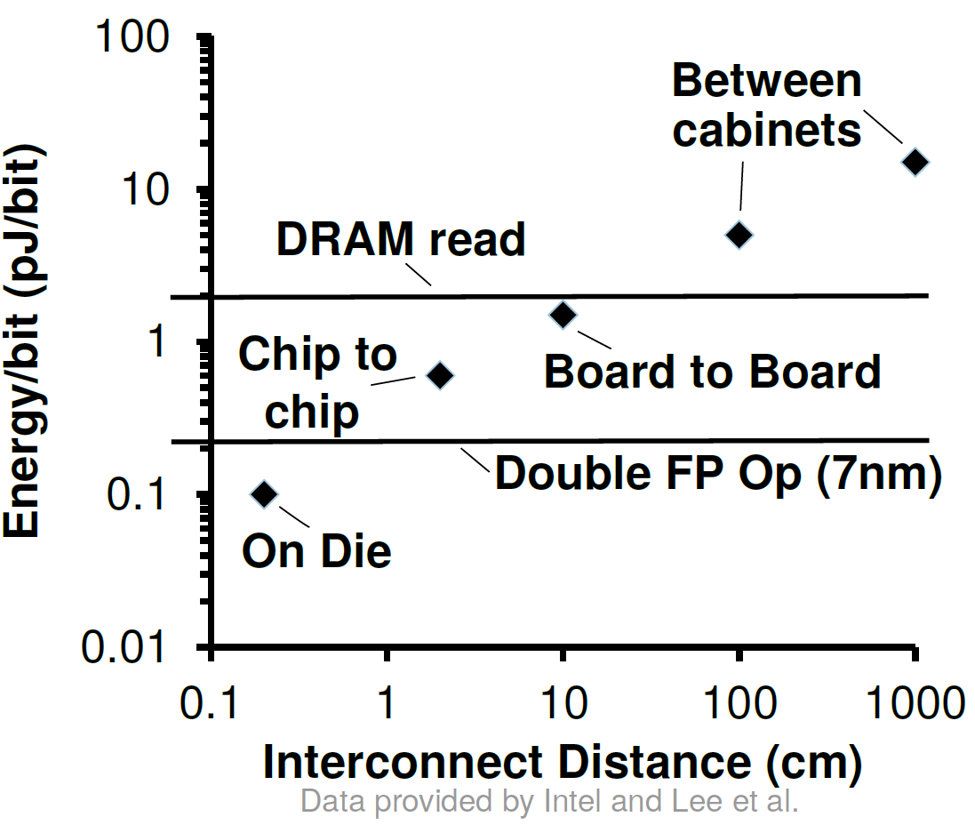
Data movement dominates energy costs!
Slide courtesy of NVIDIA
Source: Fatollahi-Fard et al.
Notes:
For the foreseeable future, data movement dominates energy costs – whatever architecture is considered, the further we must move data, the more expensive it is. Therefore, making sure data movement is optimized is paramount for energy efficiency and ultimately to performance.

Slide 16
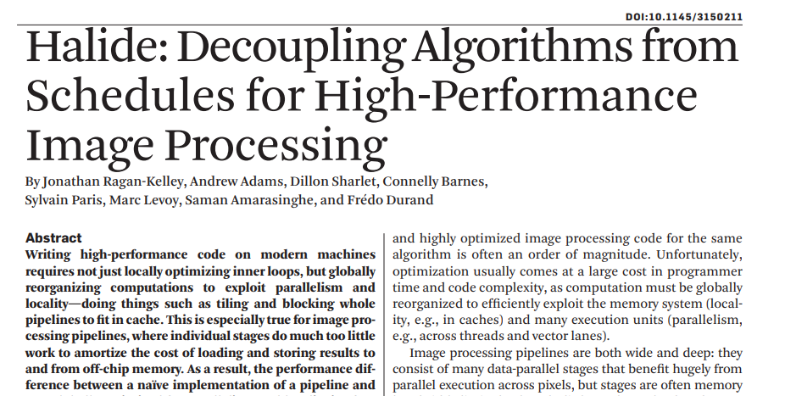
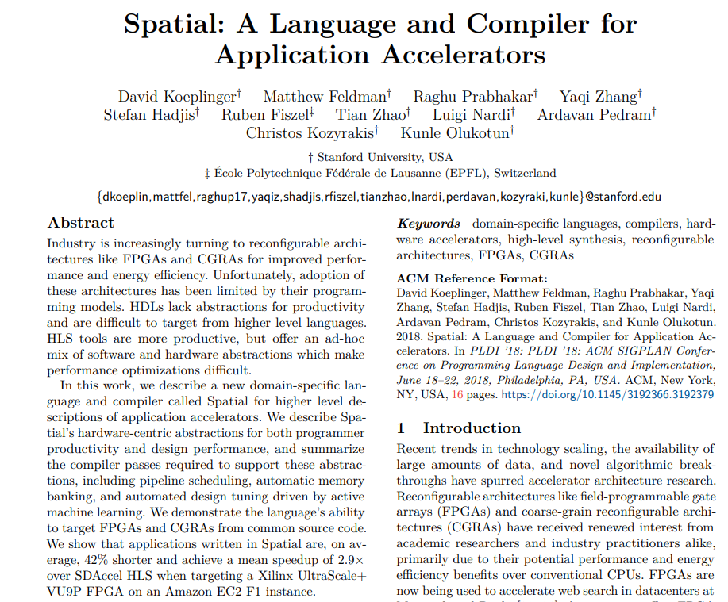
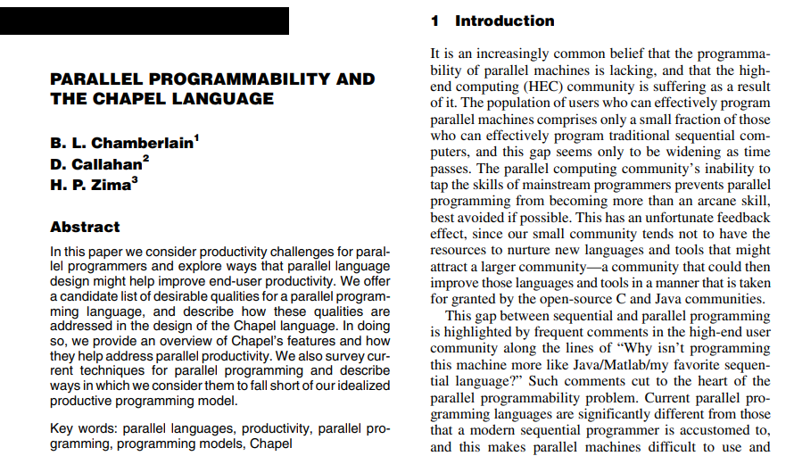
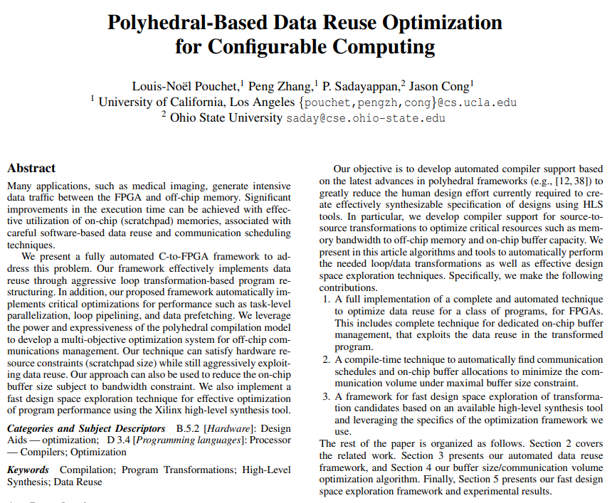
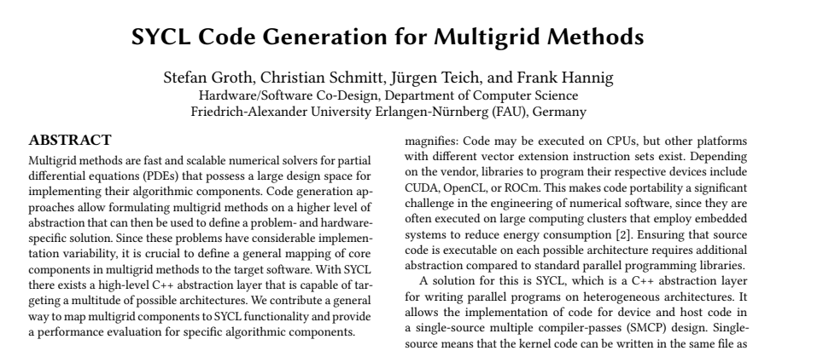
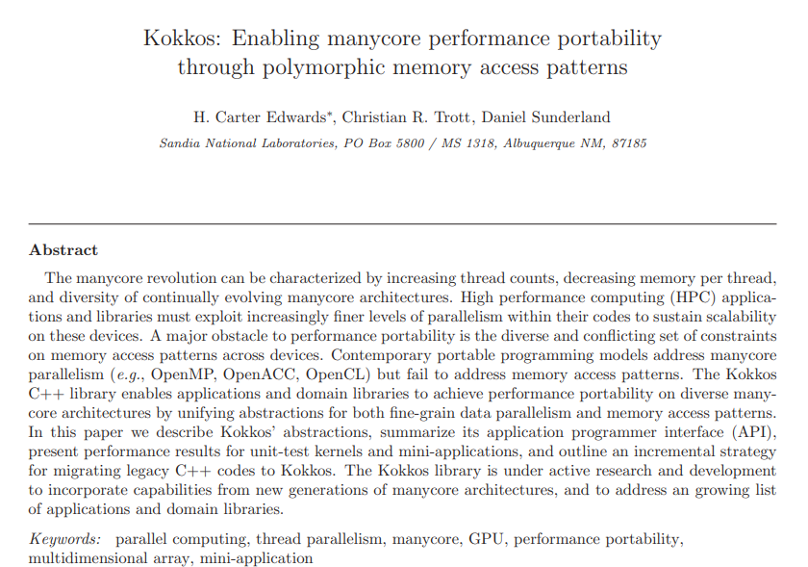
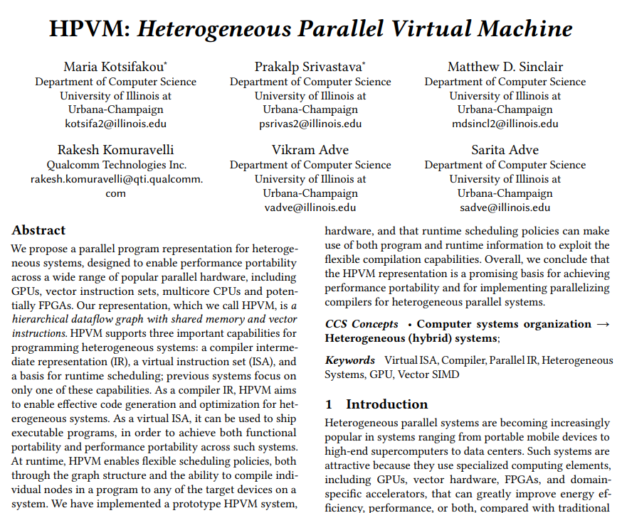
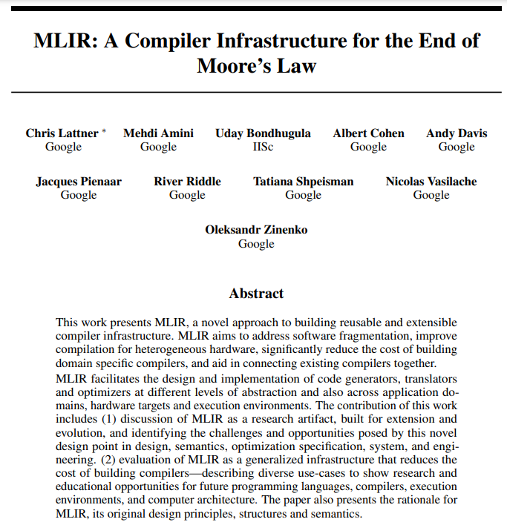
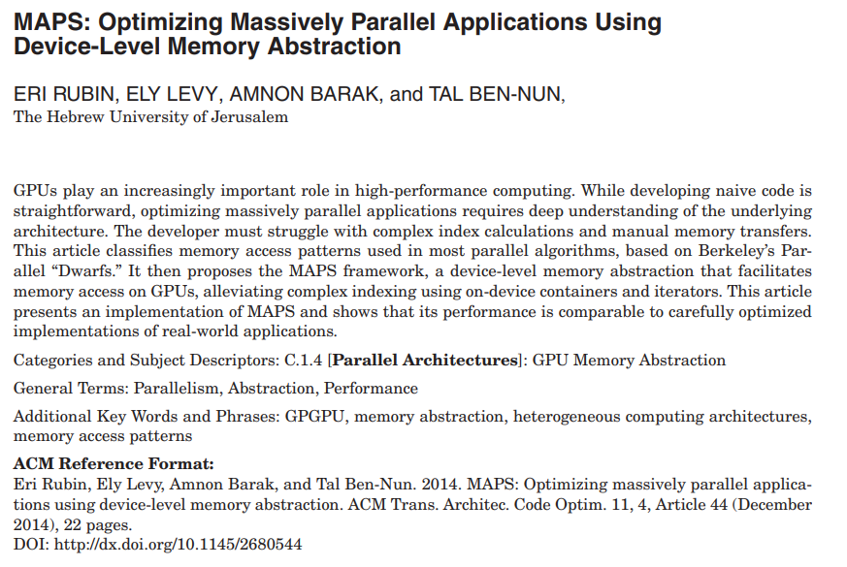
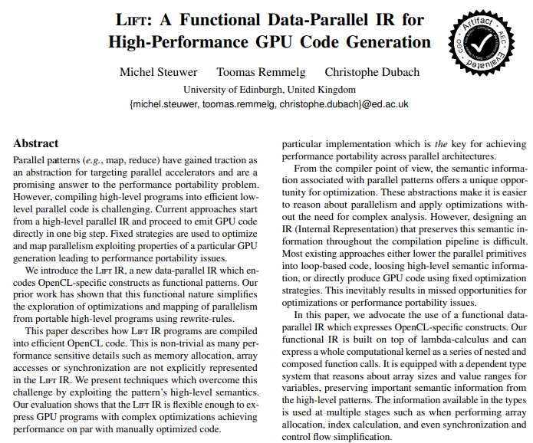
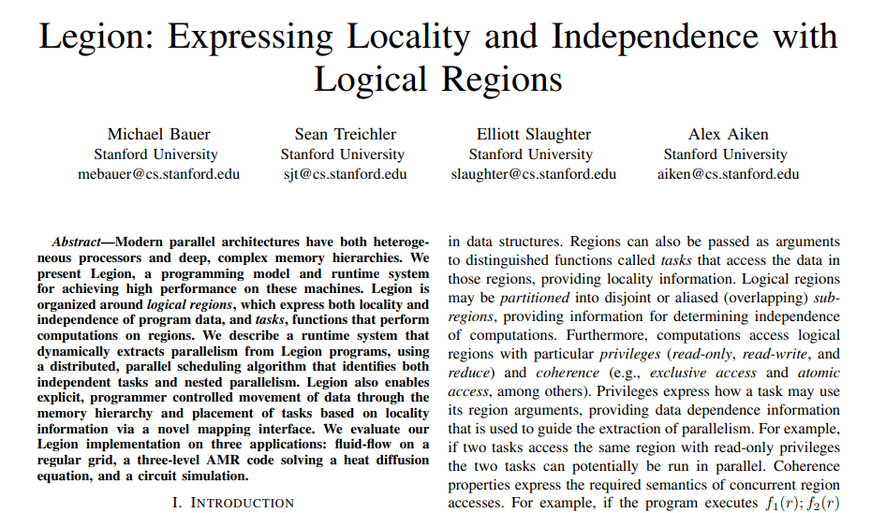
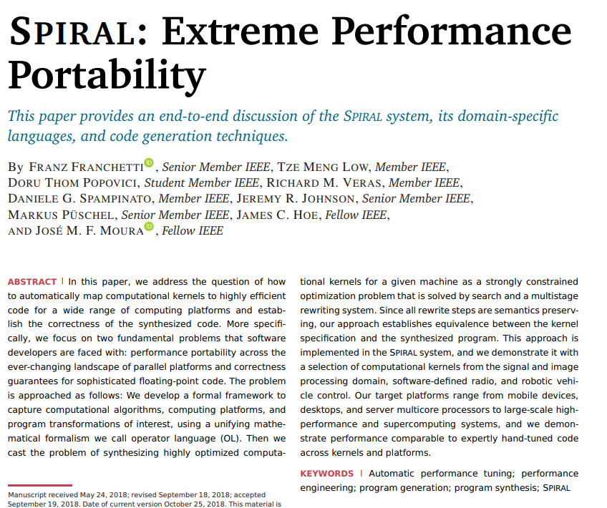
Efficient data movement is hard!
Notes:
There is a lot of research in how to do this, and while everyone agrees it’s an important topic, it’s by no means solved

Slide 17
Efficient data movement is hard!
Multi-target IR: LLVM, HPVM
Polyhedral compilers: Pluto, Polly
General compilers: GCC, Clang, ICC
Notes:
Classifying research in this area – there are Irs that generate code for multiple platforms, compilers that use polyhedral analysis to uncover parallelism opportunities, and many general compilers try to optimize for the available hardware and even auto-parallelize in the case of ICC. What makes this so hard? Pointers and aliasaing, and indirect access are significant obstacles in the way of understanding code, compounded by the fact that whole program analysis is expensive and difficult

Slide 18
C to DaCe: SpMV
WP 1
AST Transformations
for (int i = 0; i < N ; i++)
for (int j = row_ptr[i]; j < row_ptr[i+1]; j++)
y[i] += A[j] * x[col_idx[j]];

Slide 19
C to DaCe: SpMV
WP 1
AST Transformations
for (int i = 0; i < N ; i++){
for (int j = row_ptr[i]; j < row_ptr[i+1]; j++){
y[i] += A[j] * x[col_idx[j]];
}
}
Make basic blocks explicit

Slide 20
C to DaCe: SpMV
WP 1
AST Transformations
for (int i = 0; i < N ; i++){
for (int j = row_ptr[i]; j < row_ptr[i+1]; j++){
int idx = col_idx[j];
y[i] += A[j] * x[idx];
}
}
Make basic blocks explicit
Extract array indices*
And many others…
AST Transformations canonicalize the program representation and allows the translation to SDFG to make simplifying assumptions.
*All array indices are extracted, including i, i+1, j. They are omitted here for simplicity and space

Slide 21
C to DaCe: SpMV
WP 1
AST Transformations
for (int i = 0; i < N ; i++){
for (int j = row_ptr[i]; j < row_ptr[i+1]; j++){
int idx = col_idx[j];
y[i] += A[j] * x[idx];
}
}
Make basic blocks explicit
Extract array indices*
And many others…
Indirect accesses
AST Transformations canonicalize the program representation and allows the translation to SDFG to make simplifying assumptions.
*All array indices are extracted, including i, i+1, j. They are omitted here for simplicity and space

Slide 22


C to DaCe: SpMV
WP 1
AST Transformations
Translation from C to SDFG
Dataflow coarsening
Autoparallelization
A
col_idx
x
[i=0:N] (omp parallel for)
[j=row_ptr[i]:row_ptr[i+1]]
(omp parallel for)
for (int i = 0; i < N ; i++){
for (int j = row_ptr[i]; j < row_ptr[i+1]; j++){
int idx = col_idx[j];
y[i] += A[j] * x[idx];
}
}
idx = col_idx[j]
A[j]
x[idx]
Update detection
y = A * x
y[i] (Sum)
DaCe | polly | pluto | icc -parallel
y
22

Slide 23
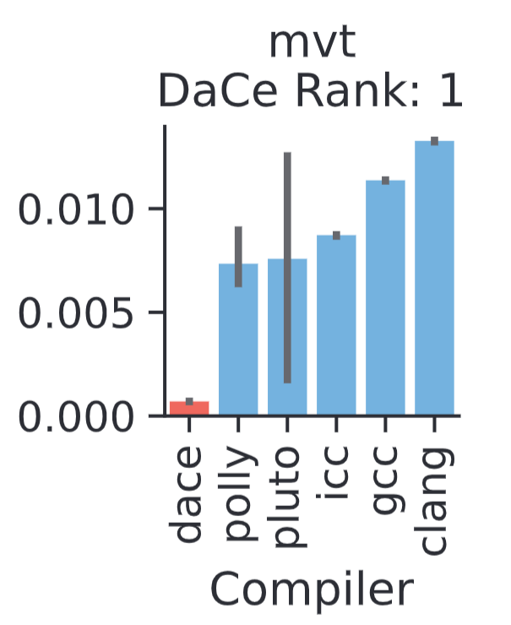
Polybench - MVT
WP 1
for (i = 0; i < n; i++)
{
for (j = 0; j < n; j++)
{
x1[i] = x1[i] + A[i][j] * y_1[j];
}
}
for (i = 0; i < n; i++)
{
for (j = 0; j < n; j++)
{
x2[i] = x2[i] + A[j][i] * y_2[j];
}
}
Update detection
Notes:
Update detection

Slide 24
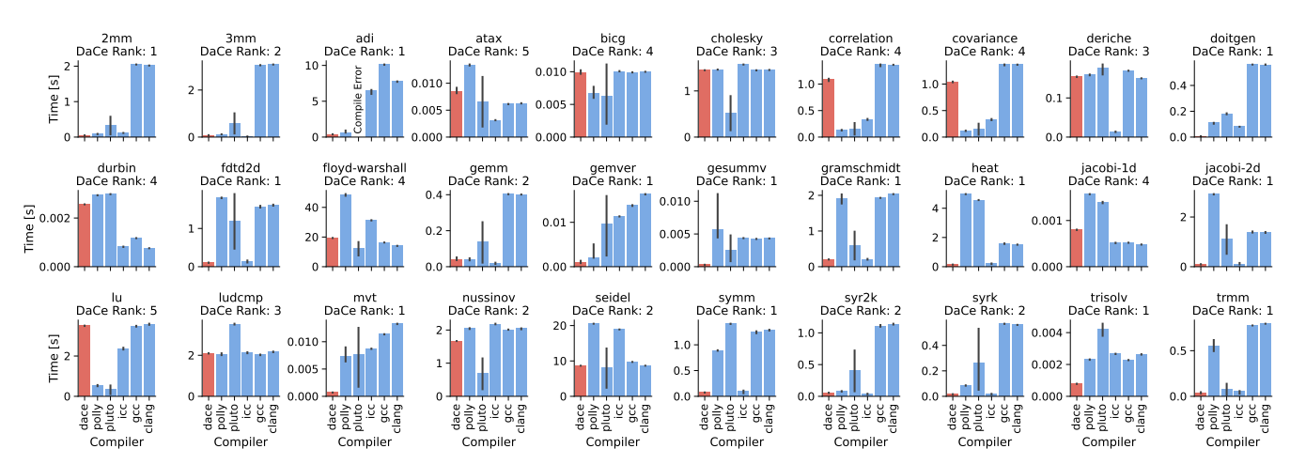
Polybench Overview
WP 1

Slide 25
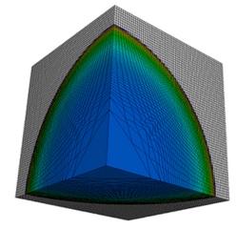
LULESH
WP 1, 5
Exascale proxy app from LLNL
Unstructured hydrodynamics solver
elemX[0] = domx[nd0i];
elemX[1] = domx[nd1i];
elemX[2] = domx[nd2i];
elemX[3] = domx[nd3i];
elemX[4] = domx[nd4i];
elemX[5] = domx[nd5i];
elemX[6] = domx[nd6i];
elemX[7] = domx[nd7i];
Indirect accesses

Slide 26
LULESH
WP 1, 5
Developers provide manually tuned OpenMP implementation
Serial result accumulation:
Parallel result accumulation:
for( Index_t lnode=0 ; lnode<8 ; ++lnode ) {
Index_t gnode = elemToNode[lnode];
domain.fx(gnode) += fx_local[lnode];
domain.fy(gnode) += fy_local[lnode];
domain.fz(gnode) += fz_local[lnode];
}
#pragma omp parallel for firstprivate(numNode)
for( Index_t gnode=0 ; gnode<numNode ; ++gnode )
{
Index_t count = domain.nodeElemCount(gnode) ;
Index_t *cornerList = domain.nodeElemCornerList(gnode) ;
Real_t fx_tmp = Real_t(0.0) ;
Real_t fy_tmp = Real_t(0.0) ;
Real_t fz_tmp = Real_t(0.0) ;
for (Index_t i=0 ; i < count ; ++i) {
Index_t ielem = cornerList[i] ;
fx_tmp += fx_elem[ielem] ;
fy_tmp += fy_elem[ielem] ;
fz_tmp += fz_elem[ielem] ;
}
domain.fx(gnode) = fx_tmp ;
domain.fy(gnode) = fy_tmp ;
domain.fz(gnode) = fz_tmp ;
}

Slide 27
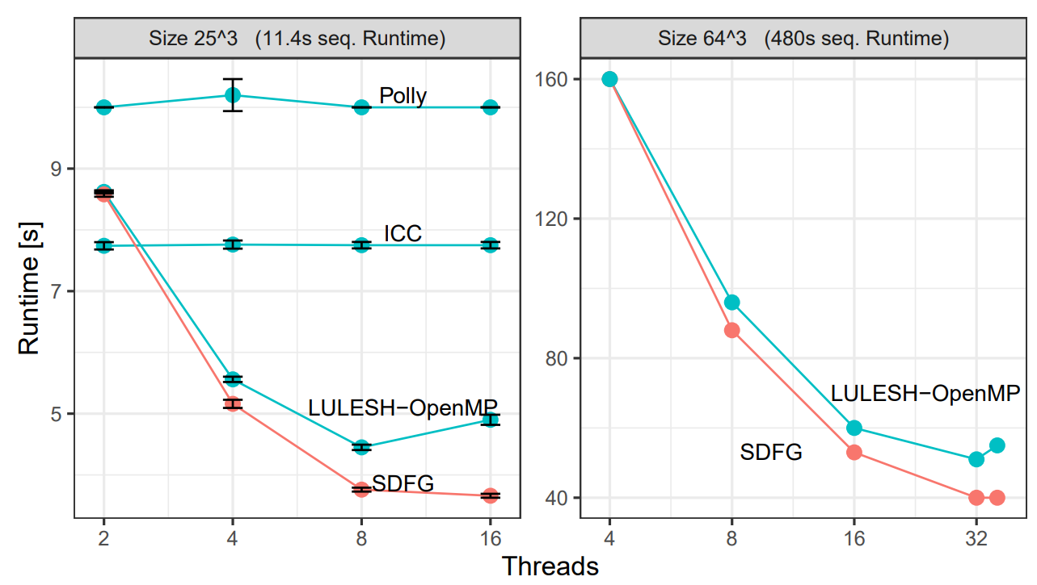
LULESH
WP 1, 5

Slide 28
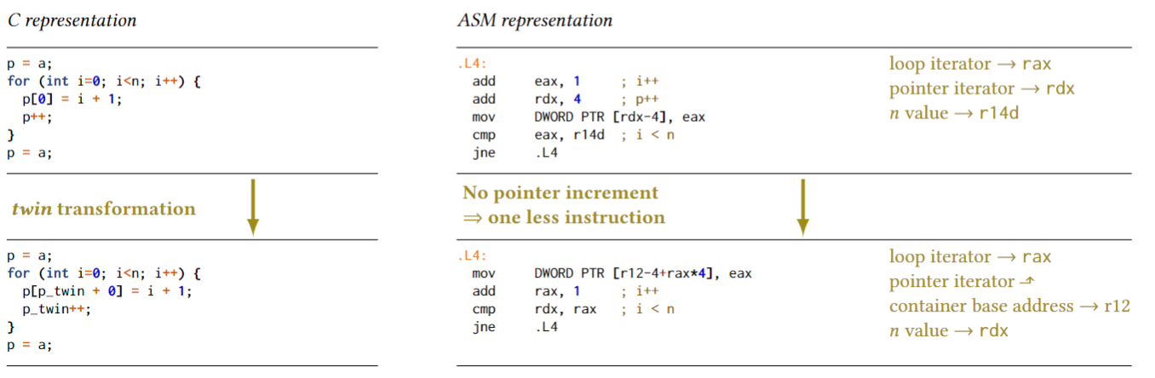
Advanced pointer analysis
WP 6

Slide 29
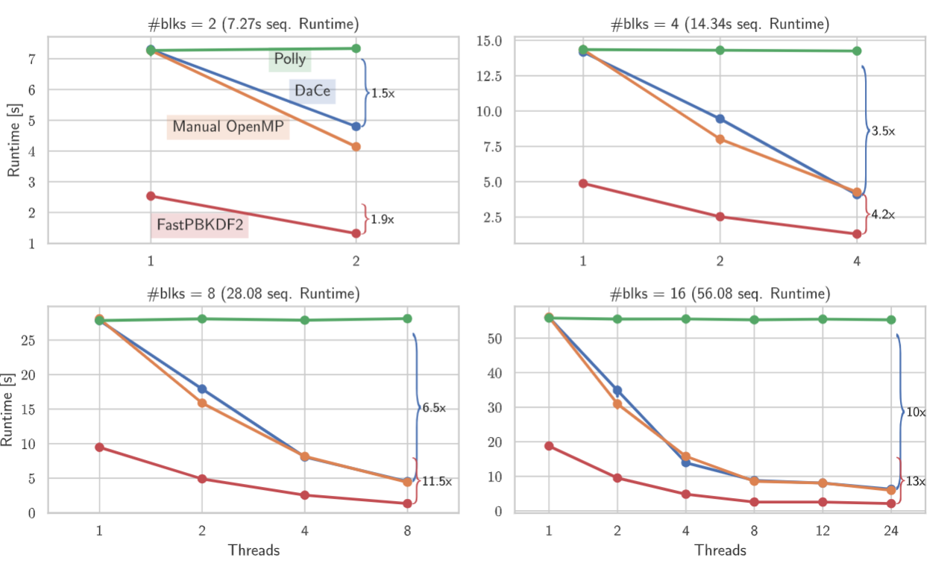
PBKDF2
WP 5, 6

Slide 30
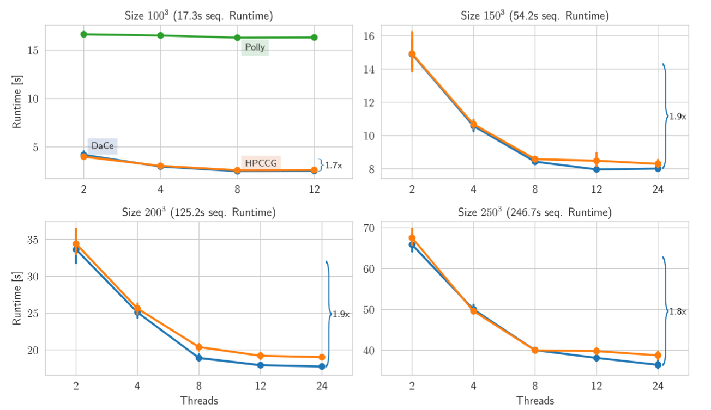
HPCCG
WP 5, 6

Slide 31
int example() {
int *A = (int *)malloc(100000 * sizeof(int));
int *B = (int *)malloc(100000 * sizeof(int));
for (int i = 0; i < 100000; ++i) {
A[i] = 5;
for (int j = 0; j < 100000; ++j)
B[j] = A[i];
for (int j = 0; j < 10000; ++j)
A[j] = A[i];
}
int res = B[0];
free(A);
free(B);
return res;
}

Slide 32

int example() {
int *A = (int *)malloc(100000 * sizeof(int));
int *B = (int *)malloc(100000 * sizeof(int));
for (int i = 0; i < 100000; ++i) {
A[i] = 5;
for (int j = 0; j < 100000; ++j)
B[j] = A[i];
for (int j = 0; j < 10000; ++j)
A[j] = A[i];
}
int res = B[0];
free(A);
free(B);
return res;
}
LICM
SIMD
clang 15.0.0
Copy
Runtime: 1.54 s
8: ; preds = %8, %5
%9 = phi i64 [ 0, %5 ], [ %34, %8 ], !dbg !253
%10 = getelementptr inbounds i32, ptr %2, i64 %9, !dbg !255
store <8 x i32> <i32 5, i32 5, i32 5, i32 5, i32 5, i32 5, i32 5, i32 5>, ptr %10, align 4, !dbg !256, !tbaa !242
...
%33 = getelementptr inbounds i32, ptr %30, i64 24, !dbg !256
store <8 x i32> <i32 5, i32 5, i32 5, i32 5, i32 5, i32 5, i32 5, i32 5>, ptr %33, align 4, !dbg !256, !tbaa !242
%34 = add nuw nsw i64 %9, 160, !dbg !253
%35 = icmp eq i64 %34, 100000, !dbg !253
br i1 %35, label %39, label %8, !dbg !253, !llvm.loop !257
%68 = load i32, ptr %7, align 4, !dbg !266, !tbaa !242
%69 = getelementptr inbounds i32, ptr %1, i64 %67, !dbg !268
store i32 %68, ptr %69, align 4, !dbg !269, !tbaa !242
%70 = add nuw nsw i64 %40, 10, !dbg !270
LLVM IR
Notes:
Let’s hand it to a state of the art compiler and see what it does
Compilers today, such as GCC and LLVM, are mostly control-centric, meaning there is instruction-driven optimization augmented by scalar dataflow analysis
None of the loops were eliminated.

Slide 33
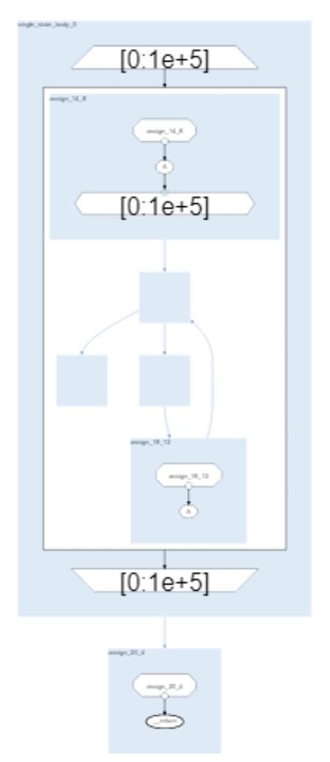
int example() {
int *A = (int *)malloc(100000 * sizeof(int));
int *B = (int *)malloc(100000 * sizeof(int));
for (int i = 0; i < 100000; ++i) {
A[i] = 5;
for (int j = 0; j < 100000; ++j)
B[j] = A[i];
for (int j = 0; j < 10000; ++j)
A[j] = A[i];
}
int res = B[0];
free(A);
free(B);
return res;
}
DaCe 0.14
+ C2DaCe
Runtime: 378 ms
SDFG (DaCe IR)
Alexandru Calotoiu, Tal Ben-Nun, Grzegorz Kwasniewski, Johannes de Fine Licht, Timo Schneider, Philipp Schaad, Torsten Hoefler. 2021. Lifting C Semantics for Dataflow Optimization
Notes:
Data centric tools: PDG, DaCe, Legion …

Slide 34

int example() {
return 5;
}
Control-Centric
Data-Centric
LICM, CSE, DCE
MCR, DME, DDE
1.54 s
0.38 s
for (int i = 0; i < 100000; ++i) {
for (int j = 0; j < 100000/8; ++j)
B[8*j..8*j+8] = 5;
for (int j = 0; j < 10000; ++j)
A[j] = A[i];
}
for (int i = 0; i < 100000; ++i) {
A[i] = 5;
for (int j = 0; j < 100000; ++j)
B[j] = A[i];
}
Notes:
But what you really want is “return 5;”

Slide 35
int example() {
return 5;
}
Control-Centric
Data-Centric
A single compiler pipeline that encapsulates both optimization classes
LICM, CSE, DCE
MCR, DME, DDE
1.54 s
0.38 s
for (int i = 0; i < 100000; ++i) {
for (int j = 0; j < 100000/8; ++j)
B[8*j..8*j+8] = 5;
for (int j = 0; j < 10000; ++j)
A[j] = A[i];
}
for (int i = 0; i < 100000; ++i) {
A[i] = 5;
for (int j = 0; j < 100000; ++j)
B[j] = A[i];
}
Notes:
But what you really want is “return 5;”

Slide 36




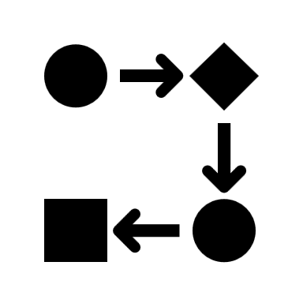



Overview
Unified Compilation Pipeline
...
%cond = ...
T
F
...
…
...
Source Code
Abstract Representation
Control-Centric
Optimization
Data-Centric
Optimization
Optimized Binary

Slide 37
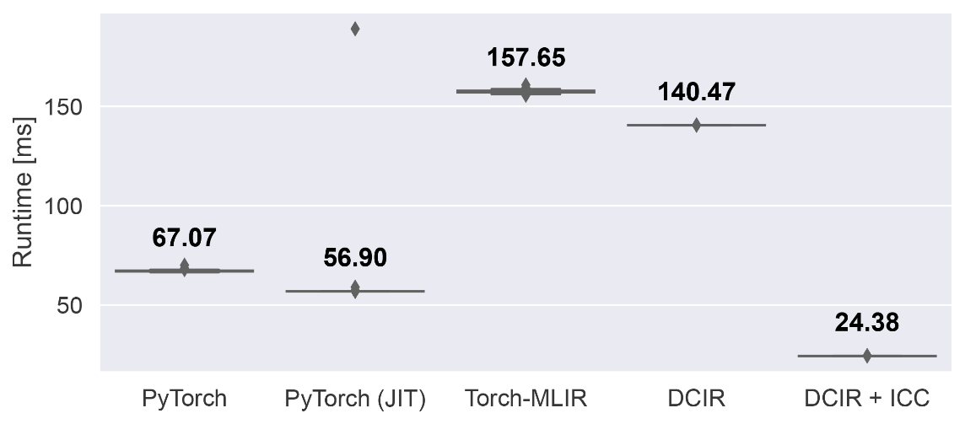
Mish Activation Function
class Mish(nn.Module):
def __init__(self):
super().__init__()
def forward(self, x):
x = torch.log(1 + torch.exp(x))
return x
Python
PyTorch
PyTorch (JIT)
Torch-MLIR
MHLO
Linalg On Tensors
DCIR
DaCe
clang++ -O3
icc –O3
DaCe
DCIR
Torch-MLIR
Torch-MLIR
PyTorch
PyTorch (JIT)
Torch-MLIR
DCIR
DCIR + ICC
MHLO
MHLO
Vectorized Math
Diganta Misra. 2020. Mish: A Self Regularized Non-Monotonic Activation Function
Notes:
Our next experiment used the mish activation function written in Python, which also demonstrates that DCIR provides data-centric optimizations while retaining the flexibility to work with arbitrary high-level IRs. For this benchmark we used a different experimental setup. Starting from the python code we directly executed the mish activation function using PyTorch and its built-in JIT compiler. Torch-MLIR allowed us to generate MLIR code in the MHLO dialect from the python code, which we used with the Linalg On Tensors backend to compile the benchmark in MLIR.
We also used the generated MLIR code to convert it to DCIR, which we optimized in DaCe and compiled with Clang++. Because PyTorch internally uses libraries for vectorized math instructions, we additionally ran the DCIR pipeline with the Intel C Compiler, called icc, to have a fair comparison.
Looking at the results we can see that DCIR outperforms the Torch-MLIR pipeline, which is caused by DCIR removing all allocation calls and fusing the computations. In our experiment we noticed that clang does not vectorize the math library calls, which is why DCIR underperforms compared with both PyTorch configurations. The Intel C Compiler, however, does generate vectorized calls and as we can see DCIR with the ICC backend outperforms PyTorch with its built-in JIT compiler by a factor of more than two.

Slide 38
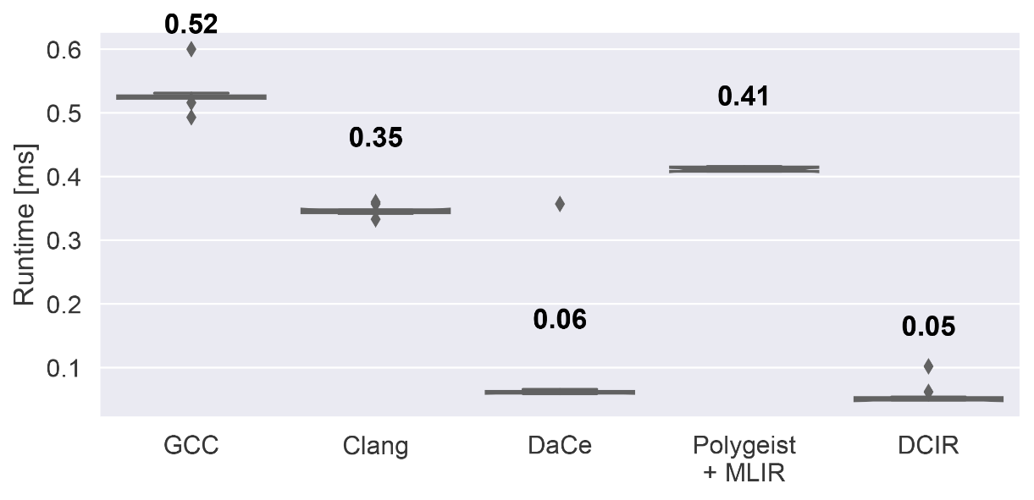
Quantum Chromodynamics (MILC)
[...]
for (j = 1; j < Norder; j++) {
if (converged[j] == 0) {
zeta_ip1[j] = zeta_i[j] * zeta_im1[j] * beta_im1[0];
c1 = beta_i[0] * alpha[0] * (zeta_im1[j] - zeta_i[j]);
c2 = zeta_im1[j] * beta_im1[0] * (1.0 - (shift[j] - shift[0]) * beta_i[0]);
zeta_ip1[j] /= c1 + c2;
beta_i[j] = beta_i[0] * zeta_ip1[j] / zeta_i[j];
}
}
[...]
Multi-Mass Conjugate Gradient Algorithm
https://github.com/milc-qcd/milc_qcd/blob/master/arb_overlap/congrad_multi_field.c
Notes:
Lastly we benchmarked a solver from the MILC codebase, which contains scientific applications in the field of lattice quantum chromodynamics written in C. In particular we used a snippet from a multi-mass conjugate gradient algorithm, which iteratively solves sparse systems of linear equations. We can see that both DaCe and DCIR achieve a speedup of seven times compared with GCC, Clang and MLIR, which is explained by two eliminated arrays, each containing 10’000 doubles.

Slide 39


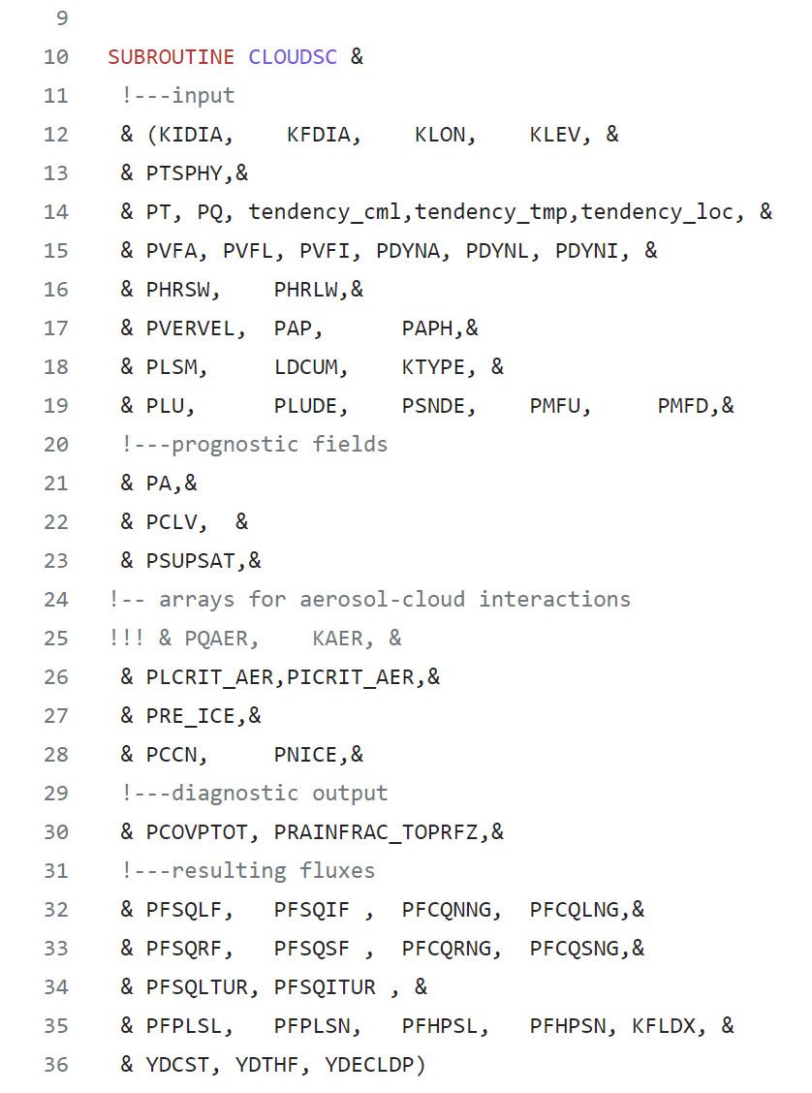
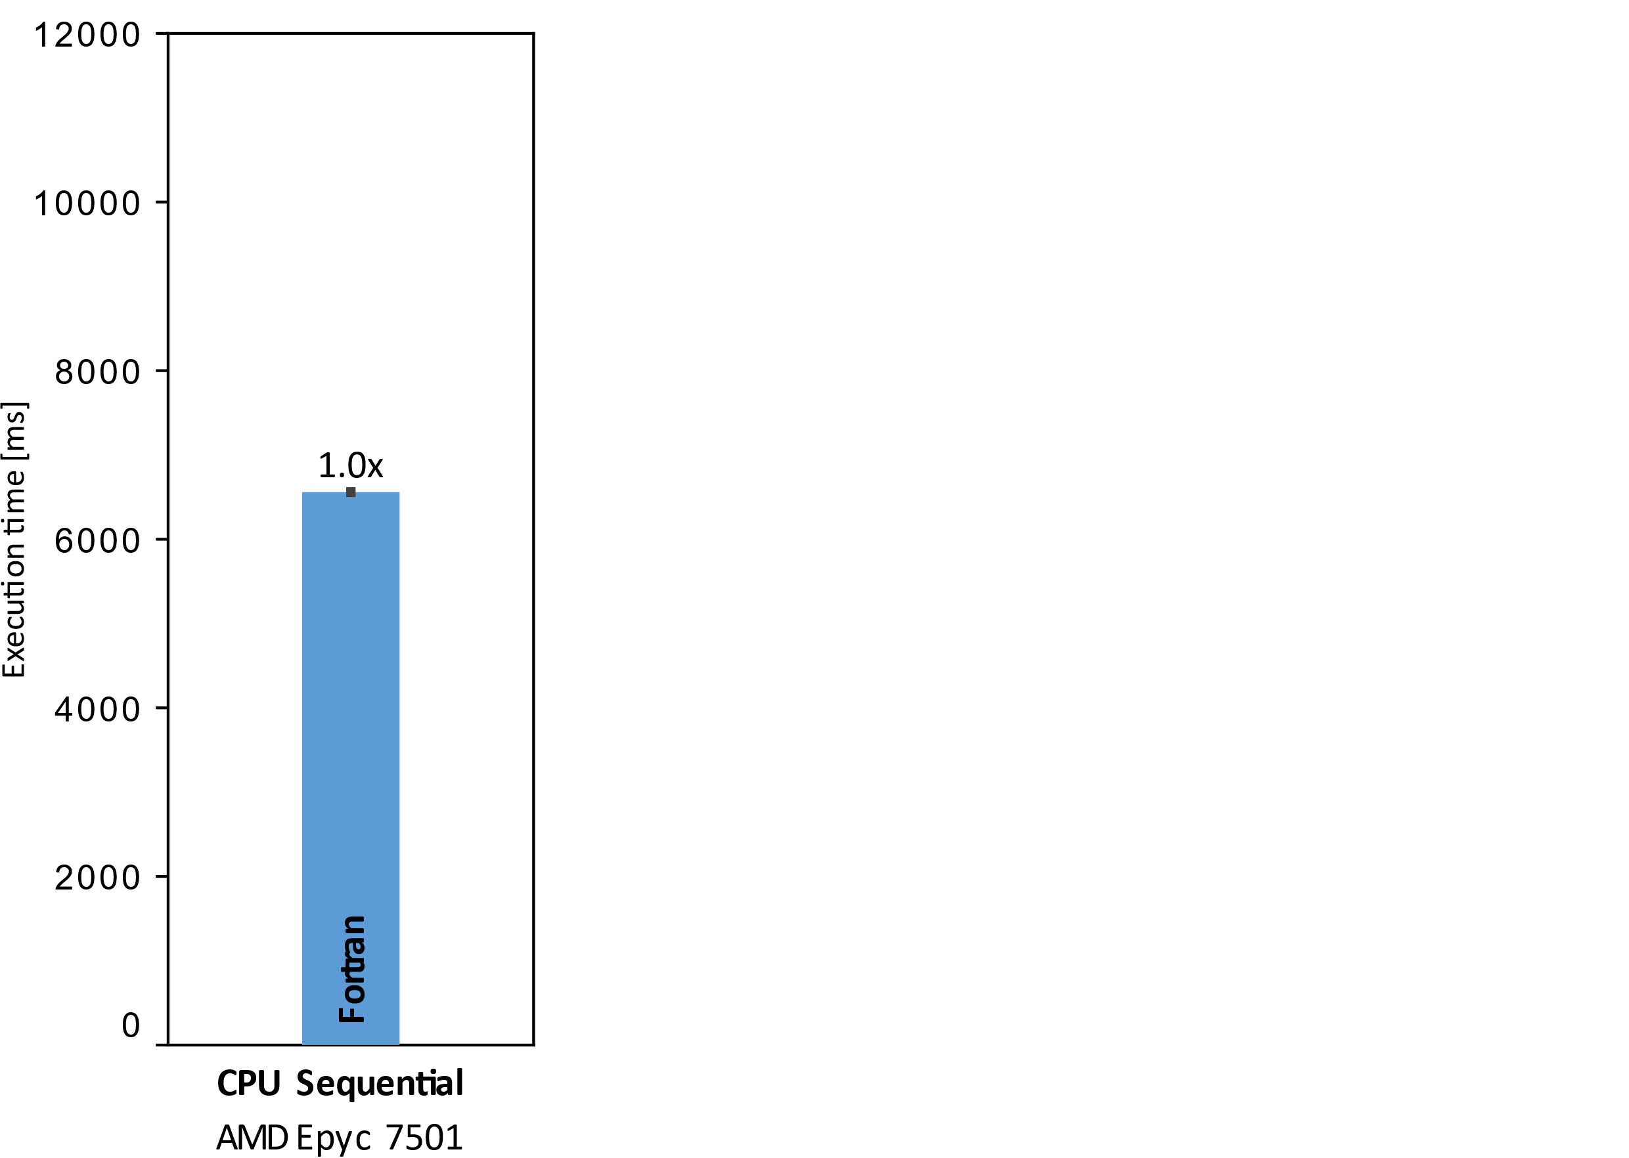
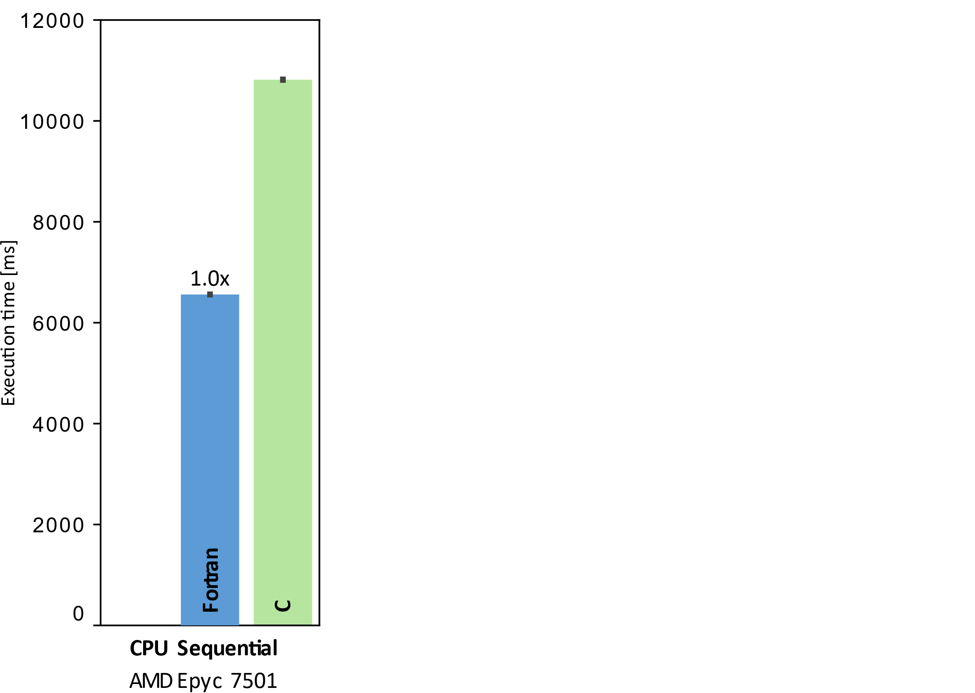
Let’s get to the real example … ECMWF’s CLOUDSC
Cloud Microphysics of IFS
Resolve sub-grid features
Original 2,525 SLOC of Fortran 95
Rewritten for performance portability benchmarking (optimization took months!)
2,635 SLOC C
2,610 SLOC C++/CUDA
… variable setup/initialization until line 500 ;-)
https://github.com/ecmwf-ifs/dwarf-p-cloudsc

Slide 40


A first simple loop from CLOUDSC*
WP 3, 4, 5
Data Parallelism
do JK=1,KLEV
do JL=1,KFDIA
ZQSM(JL,JK)=ZQSM(JL,JK)/(1.0-RE*ZQSM(JL,JK))
enddo
enddo
Fully data parallel
Work
KLEV * KFDIA
Depth
1
Average Parallelism
KLEV * KFDIA
* examples are simplified for presentation purposes

Slide 41
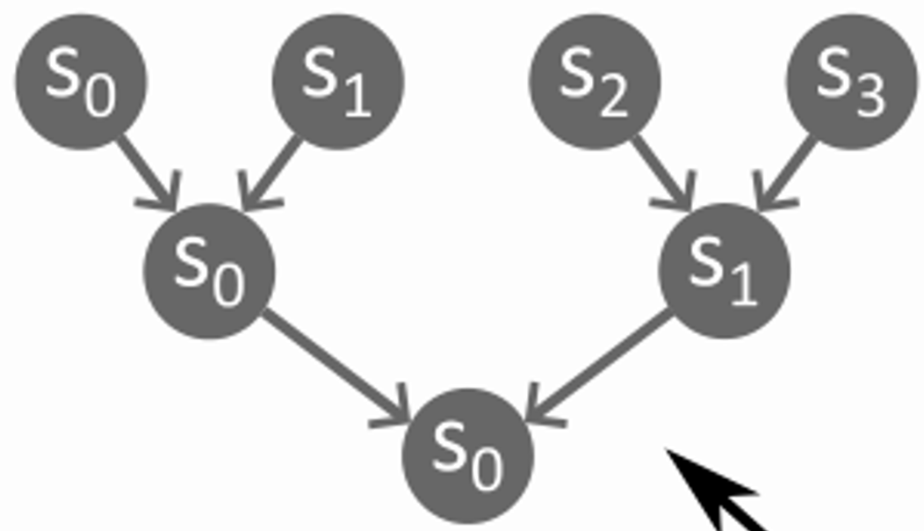
A second more complex loop from CLOUDSC
Data Parallelism
(array) accumulation prevents parallelization ☹
x
do JN=1, NSTEP-1
do JL=1, KFDIA
ZQXN(JL, NSTEP) = ZQXN(JL, NSTEP)+ZQXN(JL, JN)
enddo
enddo
Work
(NSTEP-1) * KFDIA
(NSTEP-1) * KFDIA
Depth
(NSTEP-1) * KFDIA
log₂(NSTEP-1)
Average Parallelism
1
(NSTEP-1) * KFDIA / log₂(NSTEP-1)

Slide 42



Now multiple realistic CLOUDSC loops
WP 3, 4, 5
Data Parallelism
Order Constraints
x
reuse of temporary variable prevents parallelization
x
do JM=1,4
do JK=1,KLEV
do JL=1,KFDIA
if ZQX(JL,JK,JM)<RLMIN) then
ZQADJ=ZQX(JL,JK,JM)*ZQTMST
tend_q(JL,JK)=tend_q(JL,JK)+ZQADJ
tend_T(JL,JK)=tend_T(JL,JK)-RAL*ZQADJ
ZQX(JL,JK,JM)=0.0
do JK=1,KLEV
do JL=1,KFDIA
ZQSM(JL,JK)=ZQSM(JL,JK)/(1.0-RE*ZQSM(JL,JK))
do JK=1,KLEV
do JL=1,KFDIA
ZA(JL,JK)=MAX(0.0,MIN(1.0,ZA(JL,JK)))
ZLI(JL,JK)=ZQX(JL,JK,1)+ZQX(JL,JK,2)
if (ZLI(JL,JK)>RLMIN) then
ZLFRAC(JL,JK)=ZQX(JL,JK,1)/ZLI(JL,JK)
else
ZLFRAC(JL,JK)=0.0
Happens-before
x
1
2
1
2
Control
3
2
3
RAW
4
2
4
RAW
5
2
5
WAR
No order constraint
6
7
5
8
RAW
8
8
9
RAW
9
9
10​
Control
10​
9
11​
Control
11​
Work
4 * KLEV * KFDIA * (1+4)
KLEV * KFDIA
KLEV * KFDIA * 4​
KLEV * KFDIA * 25​
Depth
log2(4) * 1 *1 * (1+2)
1
1 * 1 * (2+1)
8
Average Parallelism
KLEV * KFDIA * 10/3
KLEV * KFDIA
KLEV * KFDIA * 4​/3
KLEV * KFDIA * 25/8

Slide 43
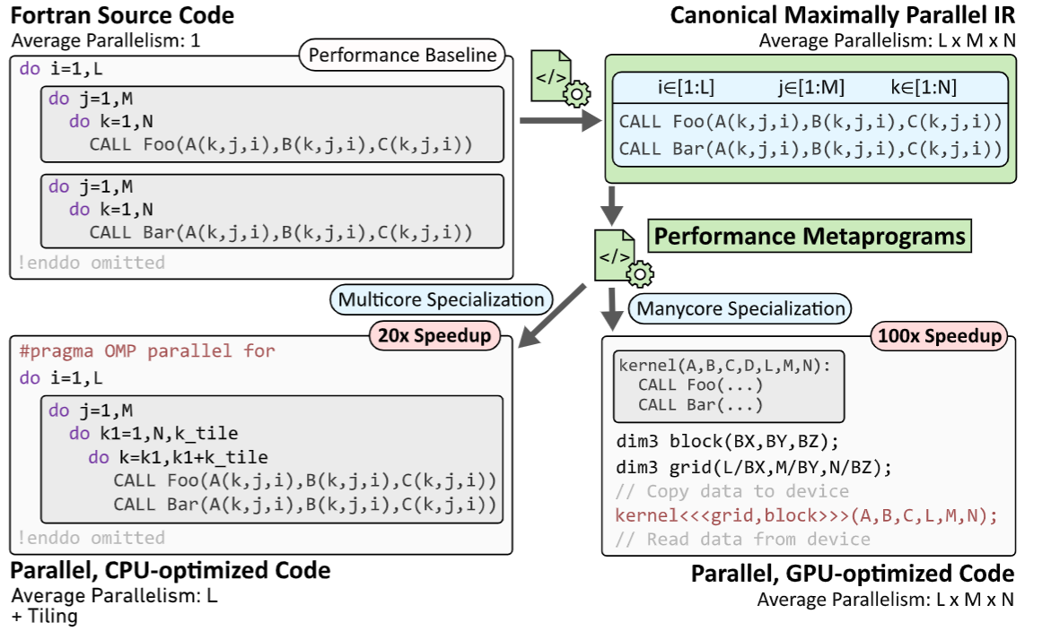
The Overall Plan
WP 3, 4, 5

Slide 44
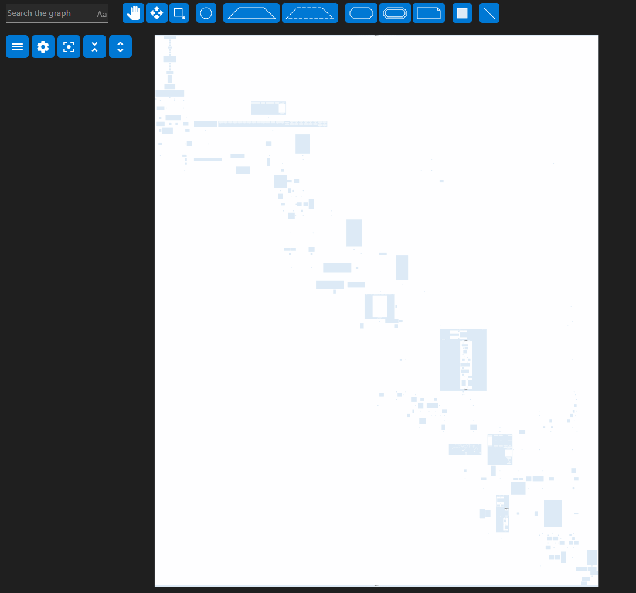
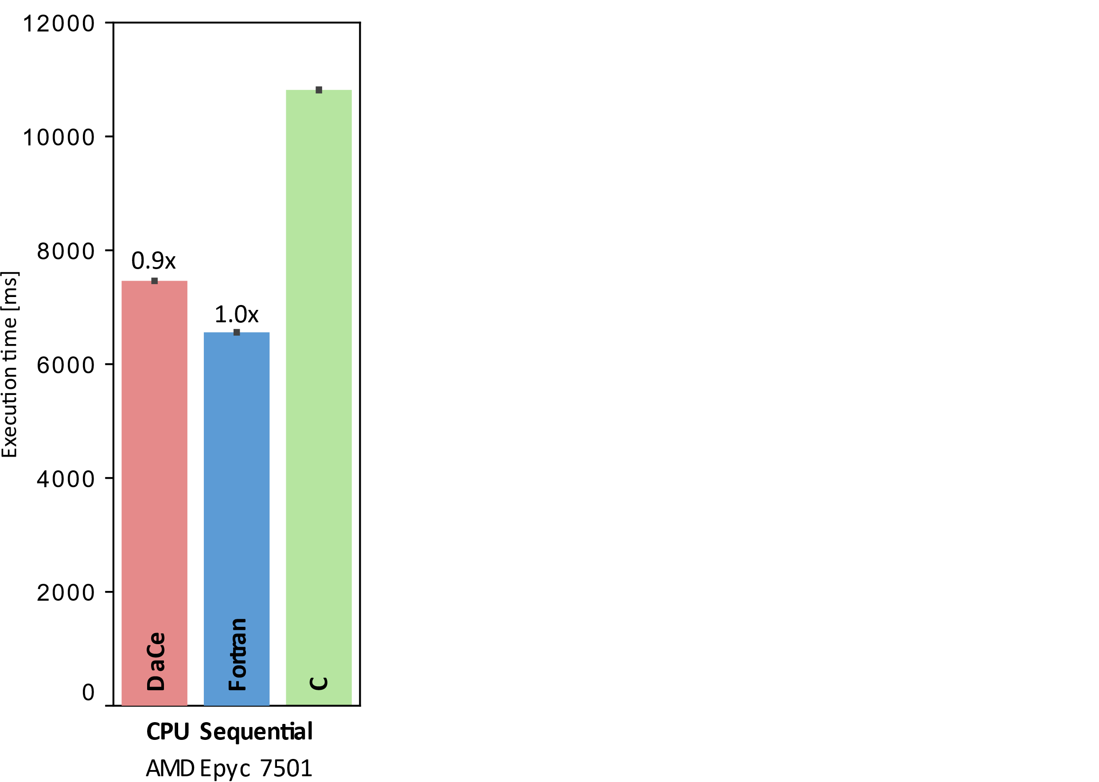
SDFG view of CLOUDSC – investigate dataflow
WP 3, 4, 5

Slide 45
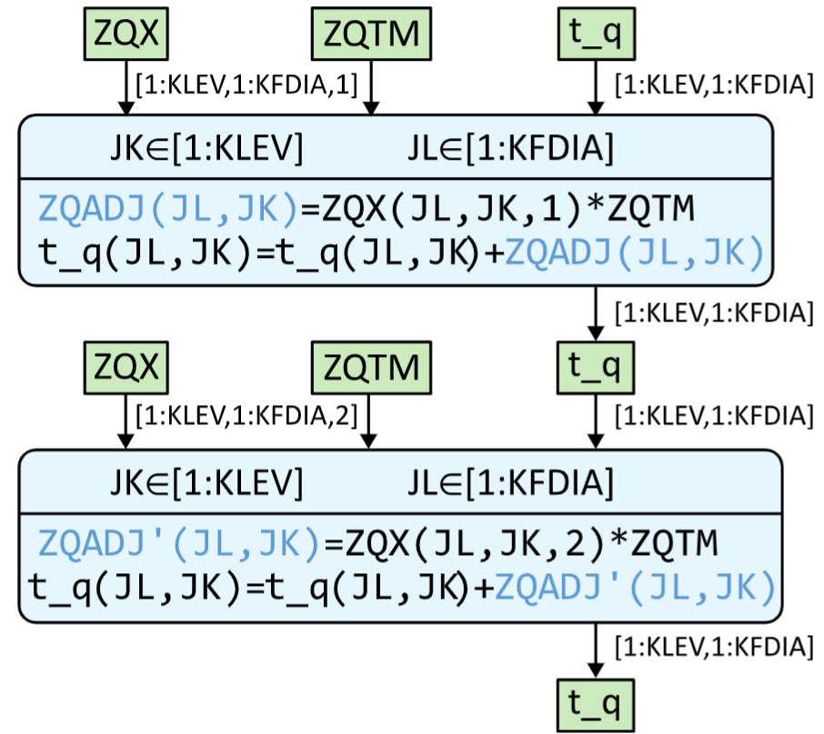
Transformations in DaCe – Performance Metaprogramming!
WP 3, 4, 5
Expose parallelism
Improve performance
Data management transformations:
Changing data container lifetime
Versioning data containers
Loop Parallelization
Specializing numerical values
Changing the data layout
1
2
do JK=1,KLEV
do JL=1,KFDIA
ZQADJ=ZQX(JL,JK,1)*ZQTM
t_q(JL,JK)=t_q(JL,JK)+ZQADJ
enddo
enddo
do JK=1,KLEV
do JL=1,KFDIA
ZQADJ=ZQX(JL,JK,2)*ZQTM
t_q(JL,JK)=t_q(JL,JK)+ZQADJ
enddo
enddo
1
2
1
2

Slide 46
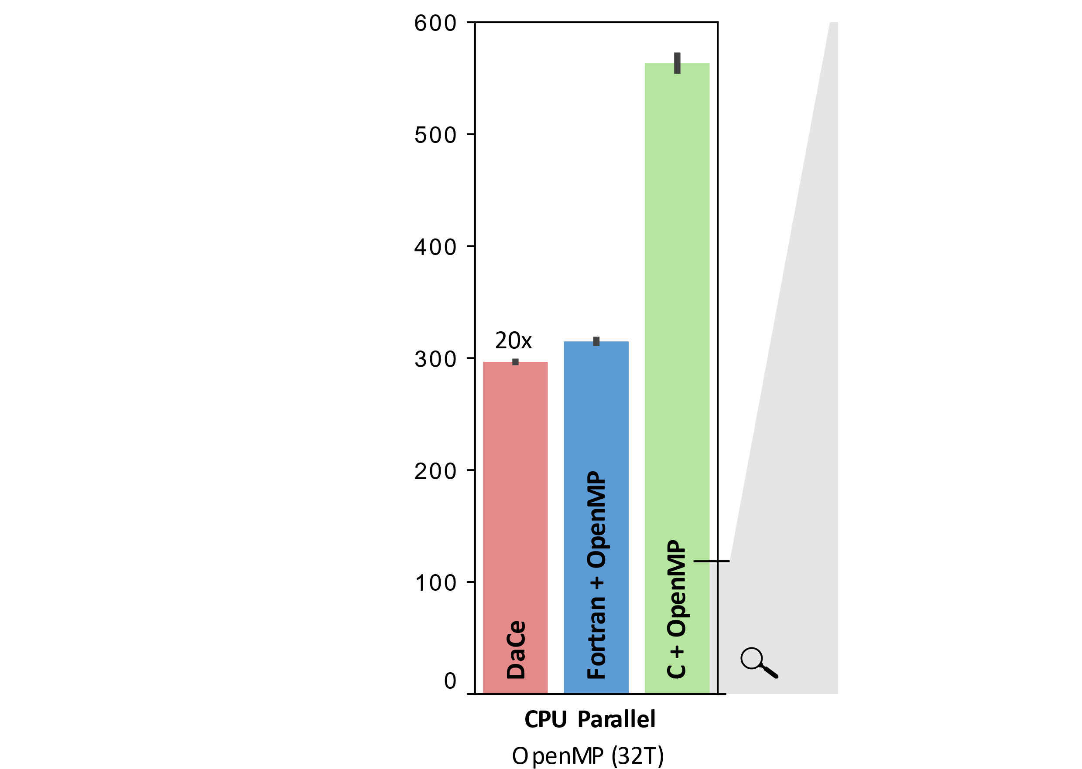
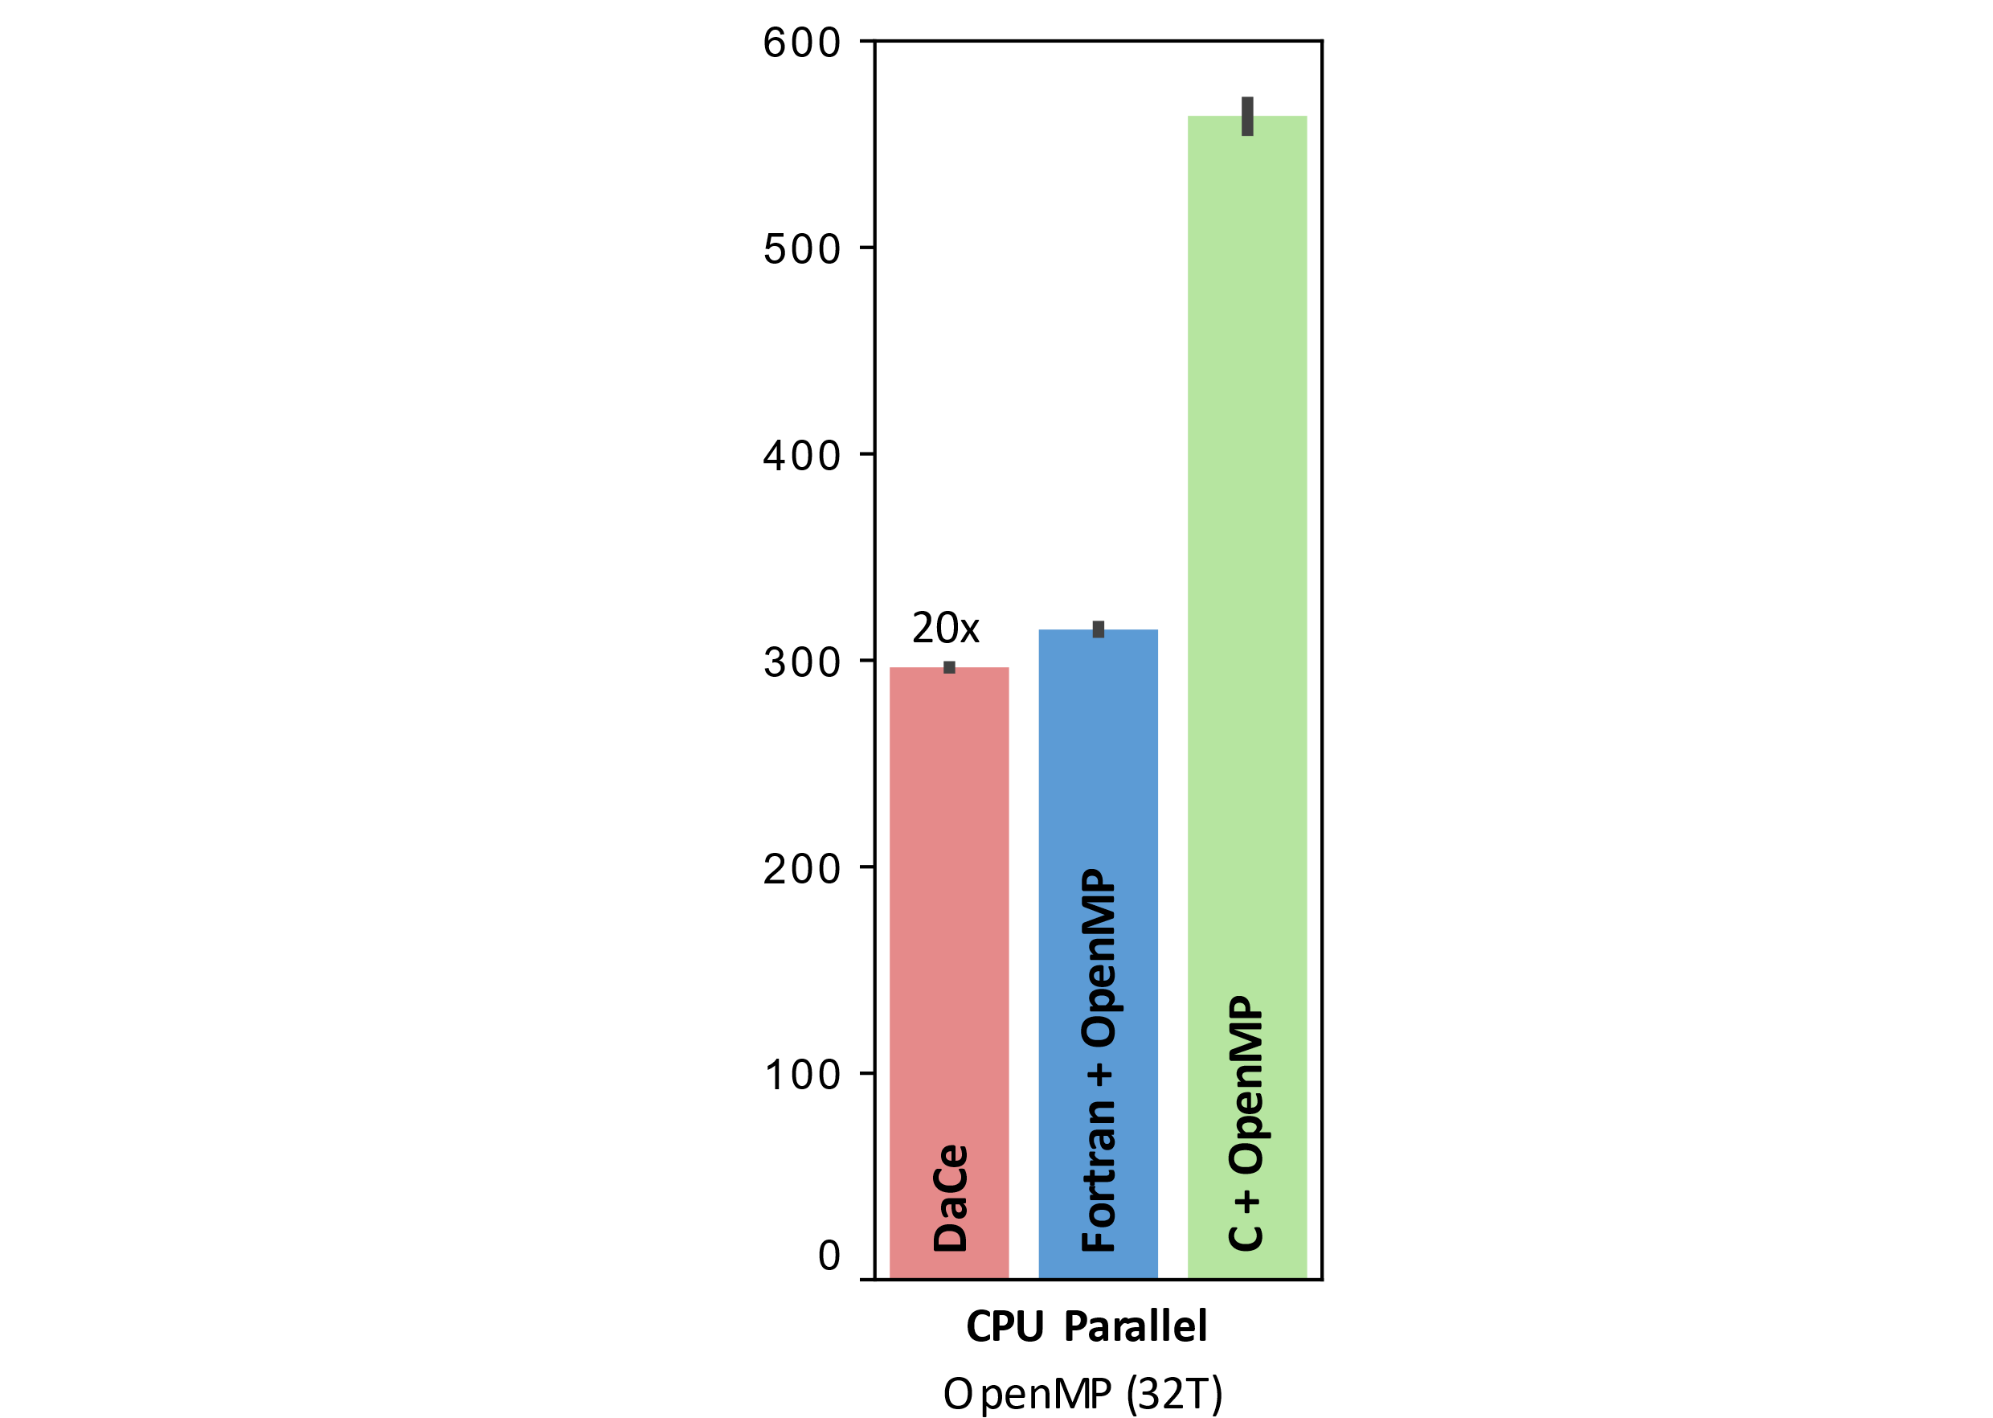
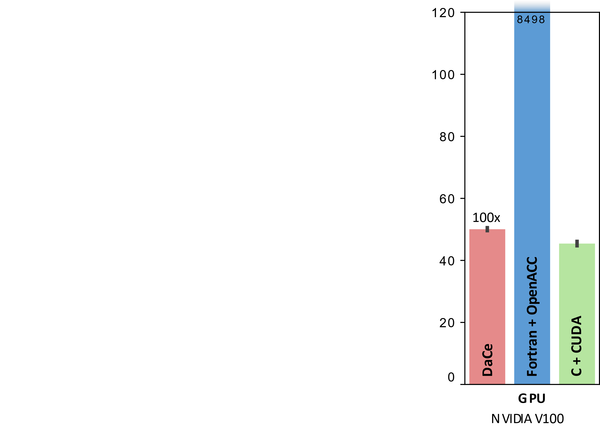
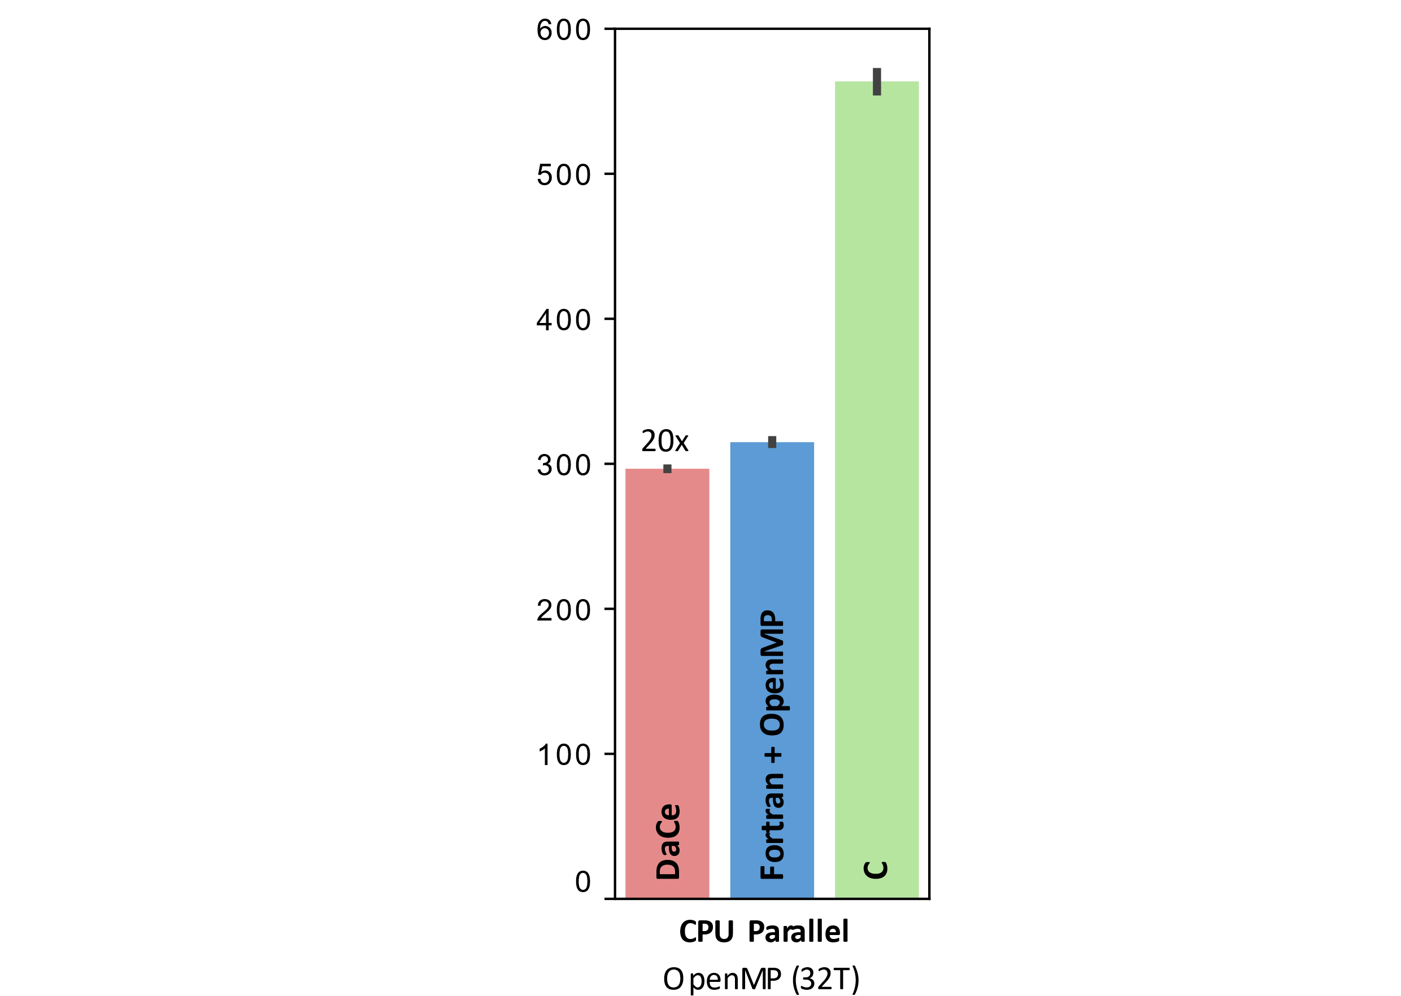
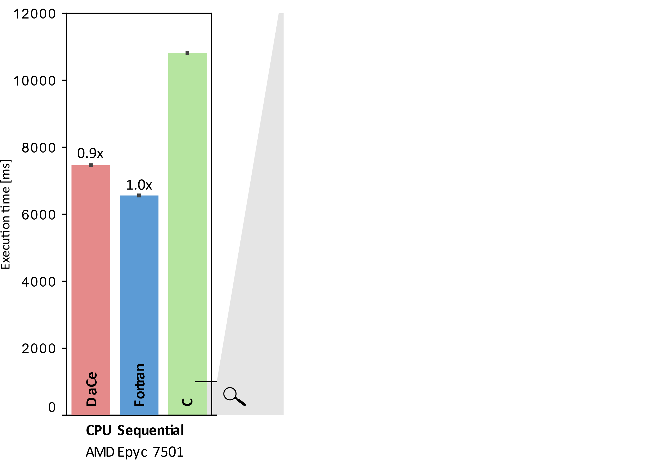
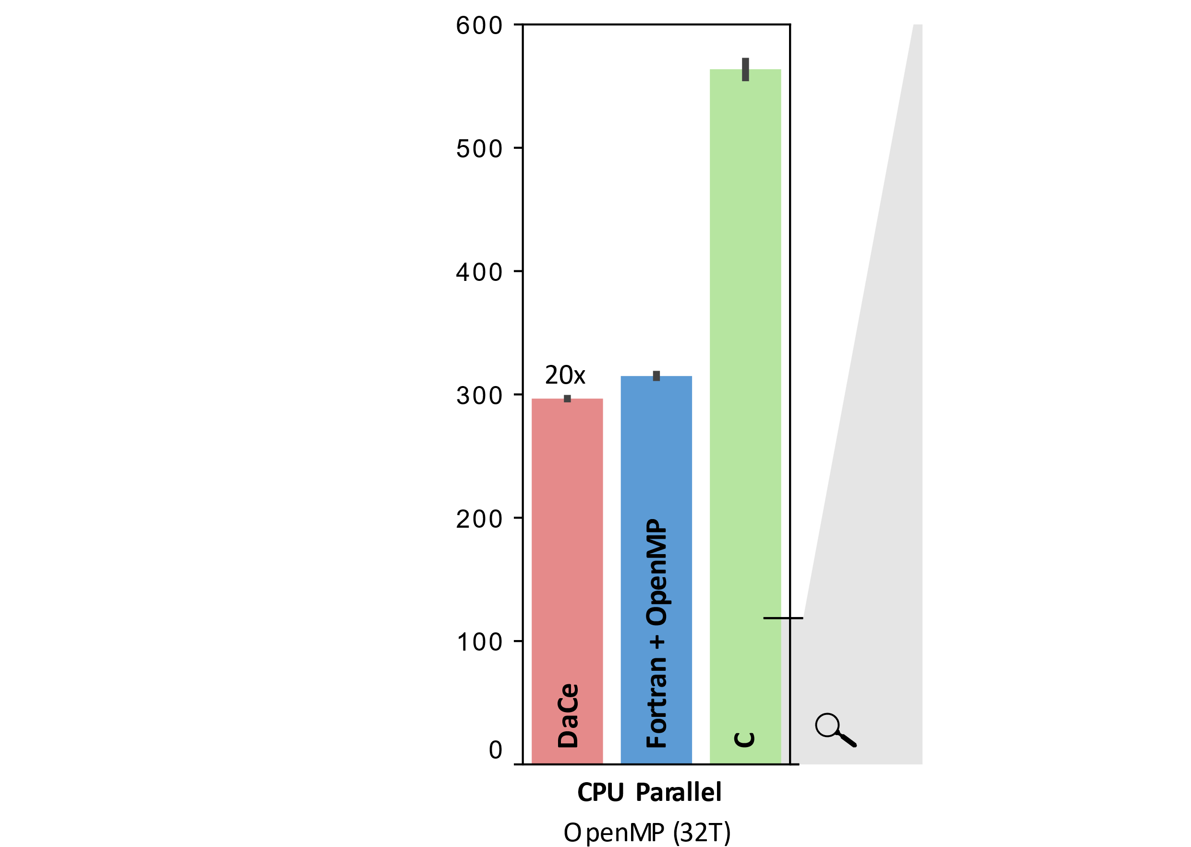
Performance portability – all from the original, unchanged CLOUDSC code!

Slide 47
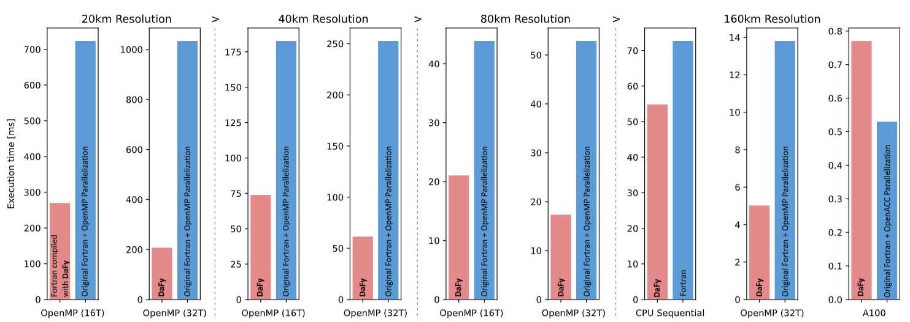
Performance portability - more weather codes
WP 3, 4, 5

Slide 48
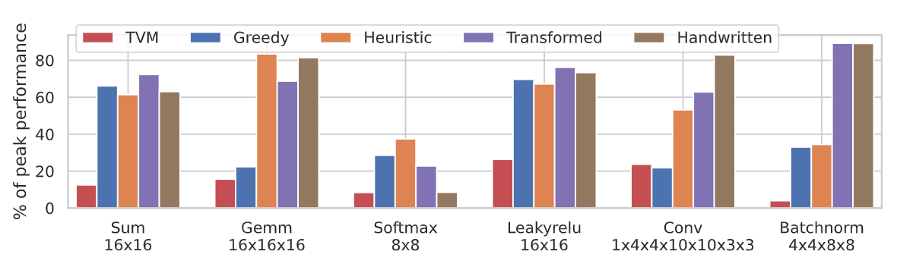
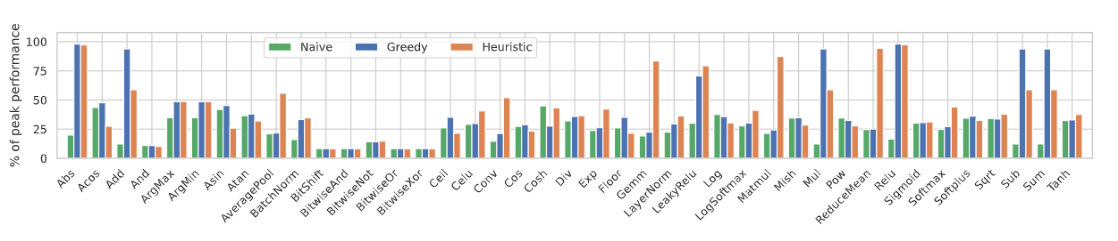
Performance portability - Snitch
WP 3, 4, 5

Slide 49
Conclusion
Understanding data movement is key to performance & portability
Paper: https://arxiv.org/abs/2112.11879 , more in submission/accepted
Code prototype: https://github.com/spcl/c2dace DaCe: https://github.com/spcl/dace

